Slide 1
Data: Analysis and Presentation
YUBA Workshop
Jeff Quinn

Slide 2
Agenda for Today
Motivation
Presentation Tools
Presentation Advice
Hands-On Workshop

Slide 3
What does “Data Analysis” Mean To You?

Slide 4
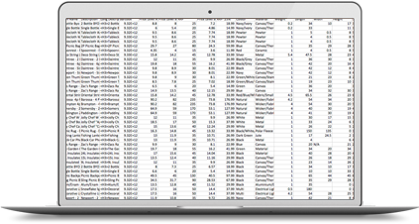

Notes:
Data analysts take a bunch of ugly, incomprehensible data and extract meaningful information from it. Data analysis sounds boring, but to me it can be a very artistic thing. Creating something that is both visually appealing, and elegantly simplifies a complex subject.

Slide 5
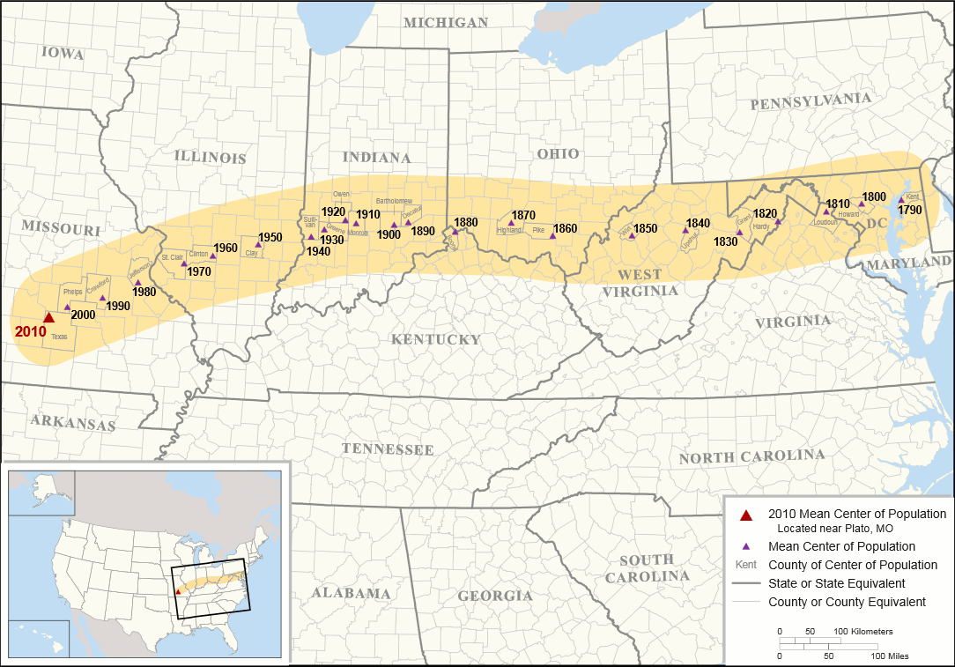
Notes:
Mean center of population in the US
Data: US population by geographical area
Message: Between 1790 and present day, the US population has moved westward more and more.

Slide 6
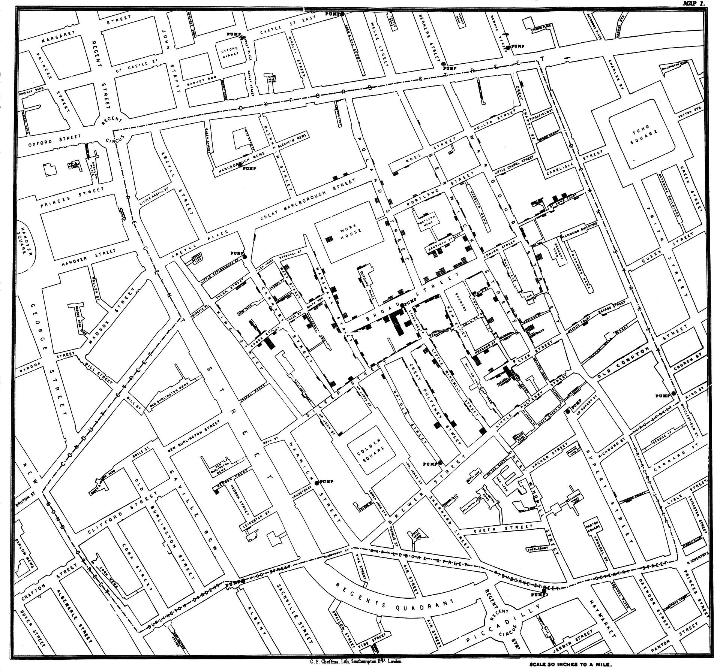
Notes:
John Snow’s Cholera map
Data: Incidences of cholera by address in london.
Message: A water pump on broad street is the source of the cholera outbreak.

Slide 7
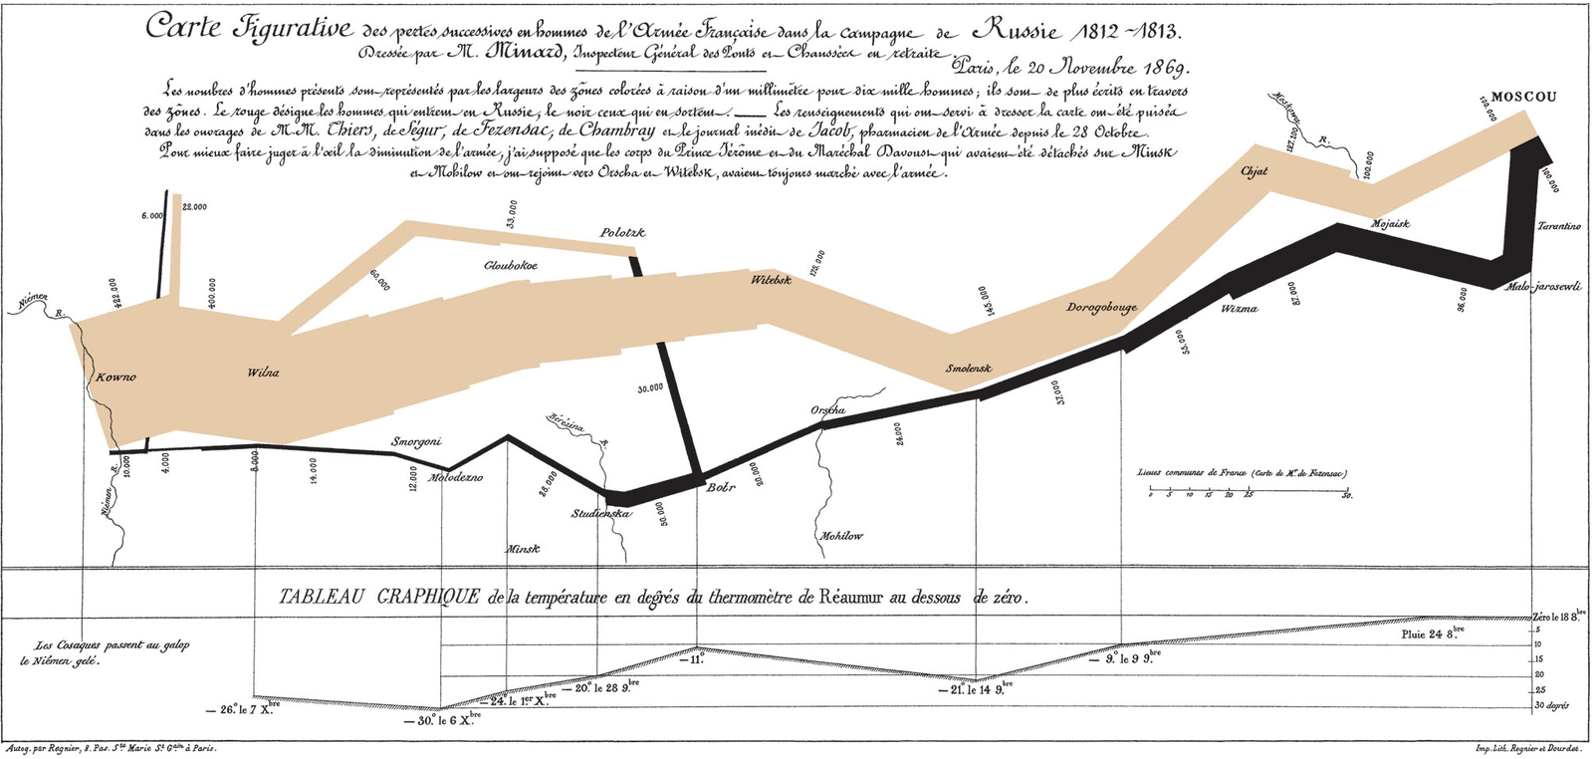
Notes:
Minard’s visualization of Napoleon’s russian campaign in the war of 1812. Napoleon marched his troops east and russian troops just kept retreating all the way to moscow, burning all the crops and shelter before they left. Eventually due to a lack of rations and exaustion, napoleon had to retreat his troops back to france, but seeing as it was nearly winter, he lost almost his entire army to cold and starvation during the journey home.
Data: Number and location of napoleon’s troops, as well as the temperature.
Message: Napoleon made a huge mistake.

Slide 8
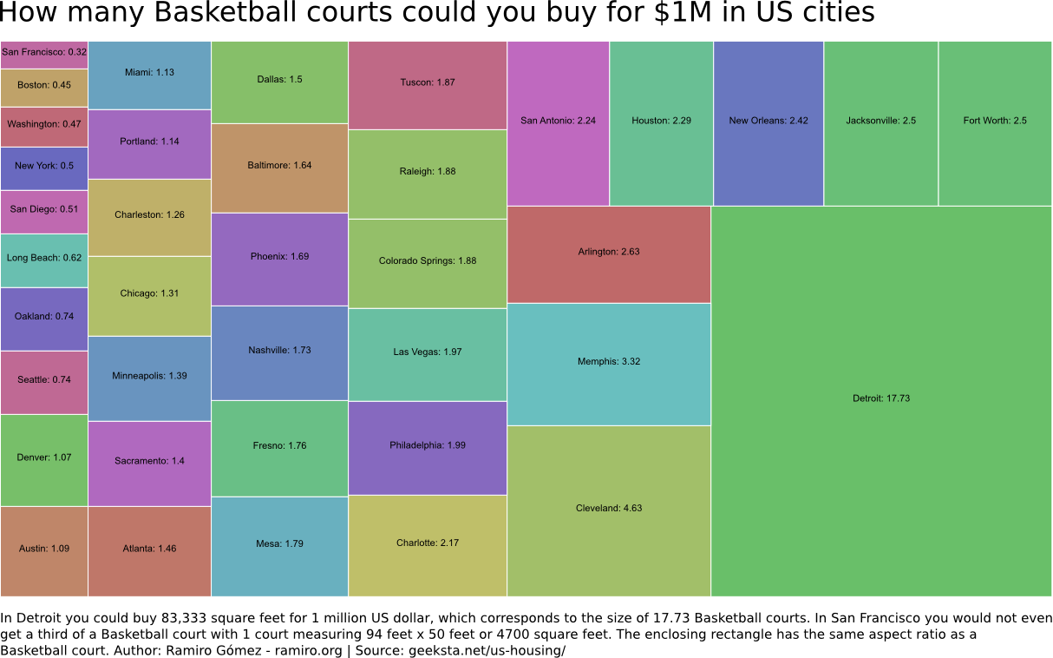

Slide 9
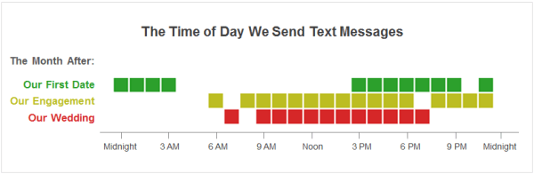

Slide 10
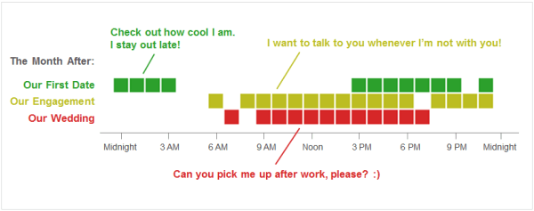
Notes:
Source: Alice Zhao
Data: Text message history with her husband
Message: Text message times and content have a certain pattern that can change over time.

Slide 11
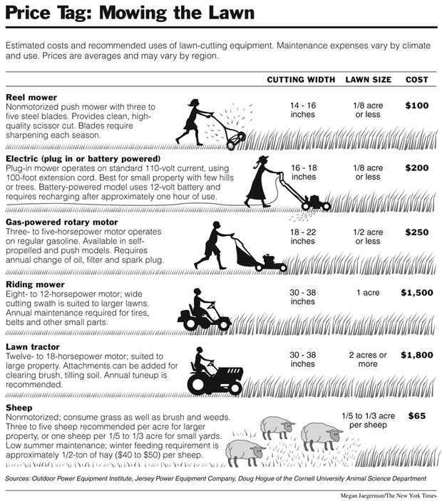
Notes:
Megan Jaegerman
Demonstrates relative costs and effectiveness of lawn cutting equipment
Data: Outdoor Power Equipment Company
Message: Maybe Sheep are the cheapest solution?

Slide 12
Data Analysis 101

Slide 13
Data Types
Quantitative vs Categorical
Continuous vs Discrete
Nominal vs Ordinal
Notes:
Quantitative: anything that can be measured numerically. Categorical: anything that cannot be measured numerically.
Continuous: Anything that has arbitrarily small step size. Discrete: Fixed step size.
Nominal: Different values cannot be ordered meaningfully, ordinal: they can
Type of data controls how you can represent it graphically

Slide 14
Summary Statistics
Mean
Median
Percentile
Range
Variance, Standard Deviation

Slide 15
Presentation Tools

Slide 16
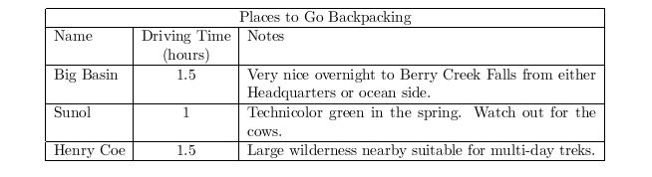
The Table
Only for a very small number of columns and rows.
Only if data values are immediately interpretable.

Slide 17
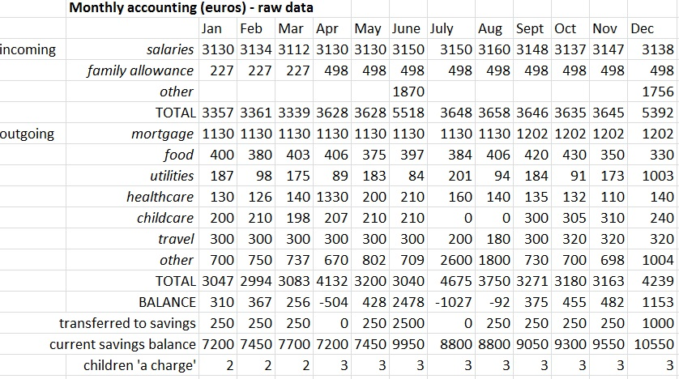
Example of a Confusing Table

Slide 18
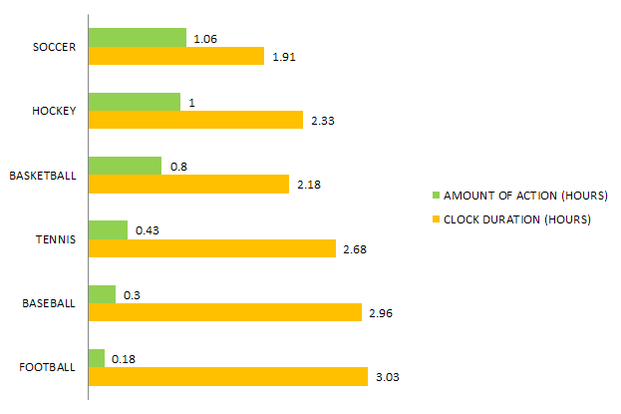
The Bar Chart
Only for a small number of categories
X-axis should have meaningful ordering
Notes:
Either order by max to min, or by increasing time, etc.

Slide 19
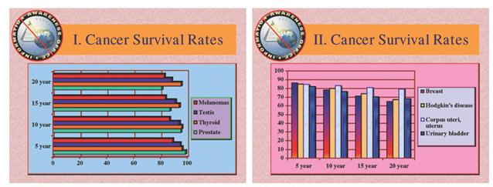
Example of a Confusing Bar Chart

Slide 20
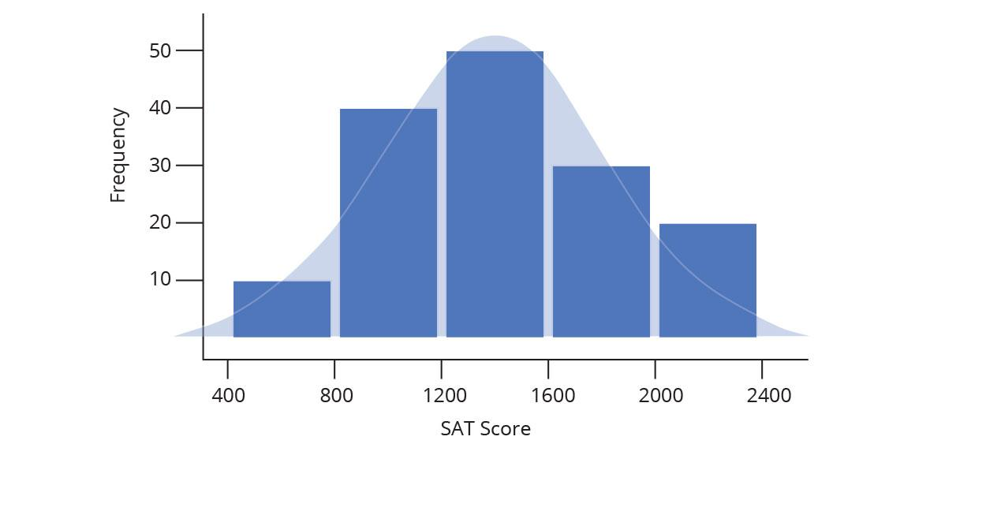
The Histogram
Used to show the distribution of some data

Slide 21
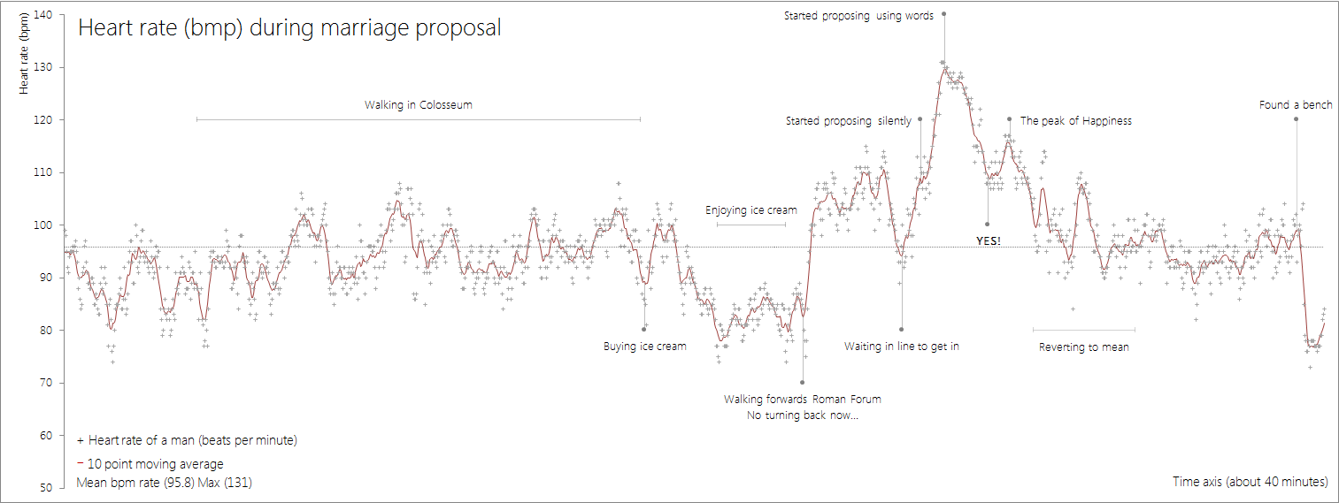
The Line Chart
More suitable for “continuous” data
Notes:
“Continuous” means data that can change bit by bit, ie time, weight, length, etc

Slide 22
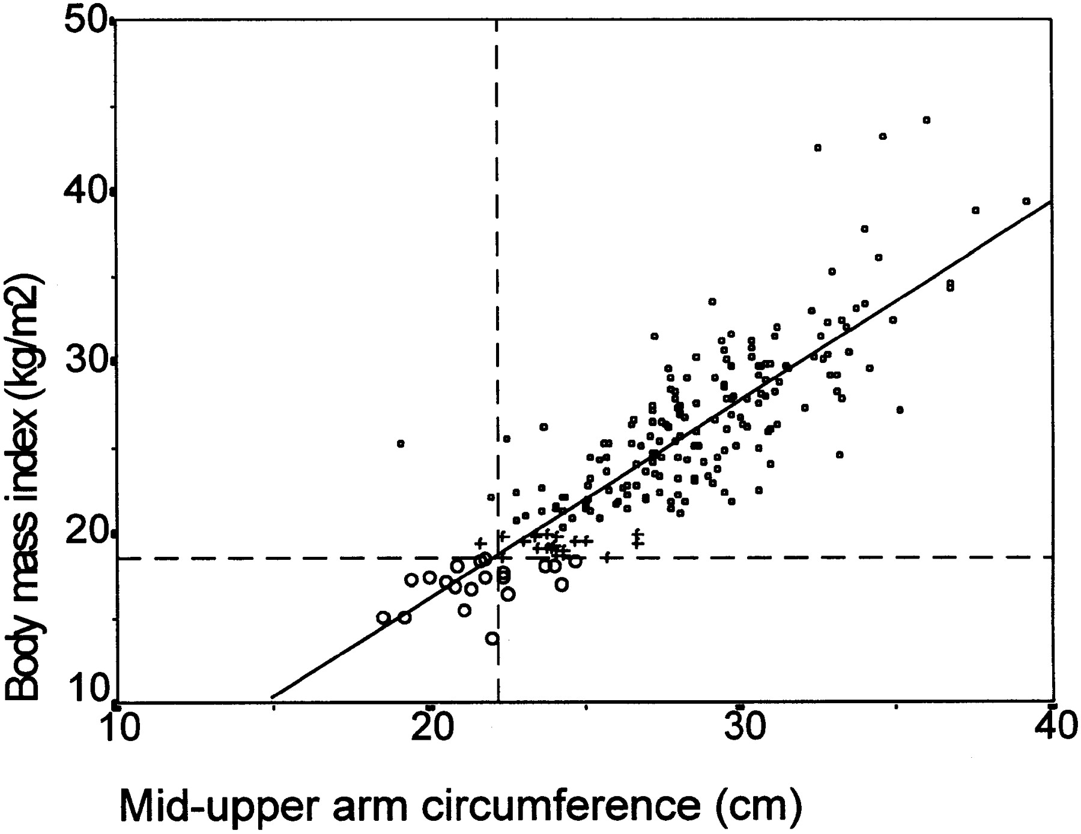
The Scatterplot
Shows relationship between two variables
Continuous or discrete/ordinal variables
Notes:
Optionally you can add a “trendline” which highlights the relationship. This trendline is from a linear regression.

Slide 23
Presentation Advice

Slide 24
Know Your Audience
Who is going to be in the room?
Will they care more about the “how”, the “why”, or the “so what?”
Notes:
If you make 10 slides going on about what your results mean for the company, but your presentation is to other data analysts, you might never get to that stuff, as they will ask mostly questions about how you carried out your analysis and whether it is correct or not. If you are presenting to the CEO, but all your slides are about how you collected and analyzed your data, they are going to be completely tuned out.

Slide 25
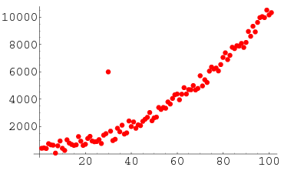
Anticipate Questions
What do you think the first question would be if you presented this scatterplot in a meeting?
Notes:
This is known as an “outlier”.
Make sure to allocate PLENTY of time to questions whenever you show a figure or visualization that you’ve made, unless it is really simple or they have seen it before.

Slide 26
Don’t Drown in the Details
Ease your audience into the presentation
Protect your audience from the ugly stuff when you can
Notes:
Don’t start a presentation talking about the low level details. Start by talking about your motivations, what you wanted to learn, and then talk about your data and how you used it.

Slide 27
But, try to Know the Details
In the course of Q&A, people might end up asking really detailed questions about your data set
Always be honest if you don’t know some detail
Notes:
You’ll confuse people if you try to act like you know why something is when you don’t, or you might insult their intelligence.

Slide 28
Dataset for Today’s Workshop

Slide 29

Integrated Postsecondary Education Data System
System of surveys conducted annually and made public by the U.S. Department’s National Center for Education Statistics (NCES).
Collect info on enrollment demographics, tuition, financial aid, graduation rates, and institutional resources.
Has info on every college, university, and technical and vocational institution that participates in the federal financial aid programs.

Slide 30
bit.do/6Xyh
Notes:
Enter this link in your browser to download the dataset

